Slide 1
Introduction to Geoinformation Science
Marco Heinzen Deputy Head Software & Integration C5I
Data Engineering – Data Science - Geoinformatics

Slide 3
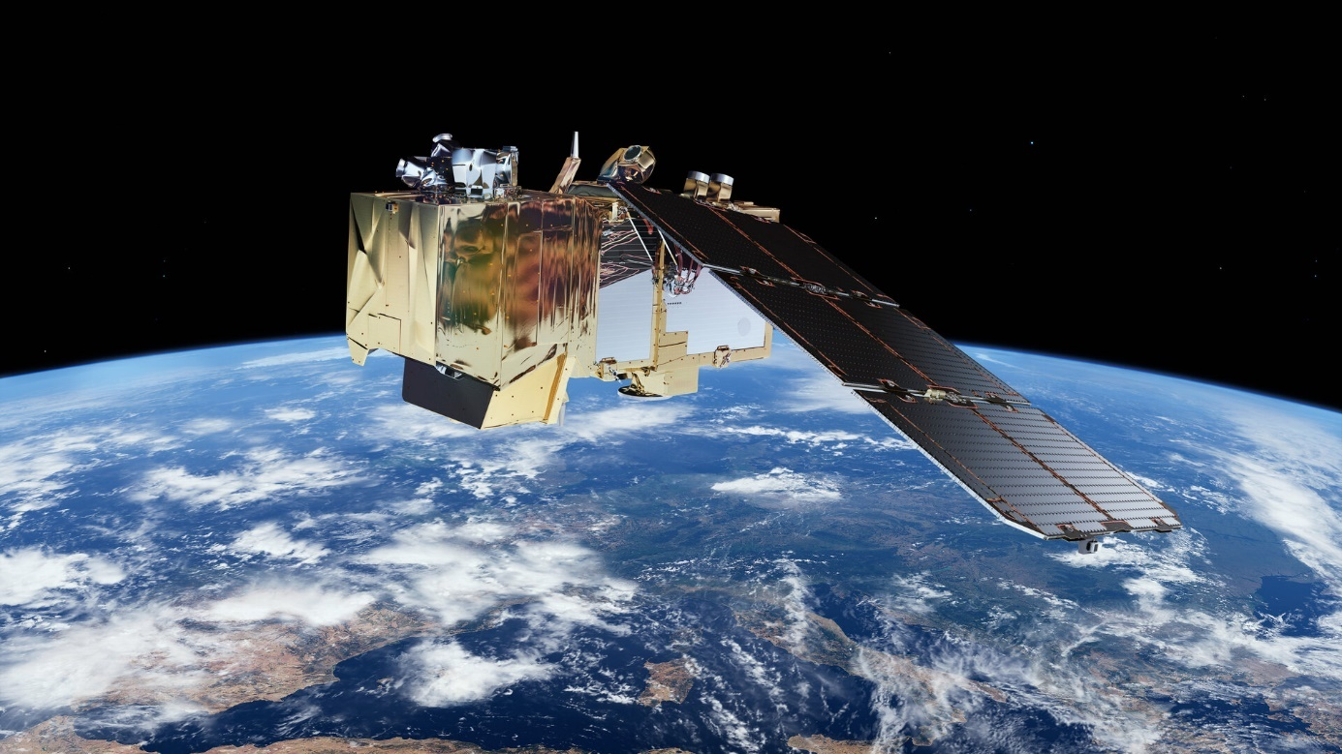
Introduction to Remote Sensing Imagery & Principles
Figure 1: Sentinel-2 Satellite, Source: ESA
Sentinel-2 Satellite, Source: ESA

Slide 4

Marco Heinzen Deputy Head Software & Integration C5I: Data Engineering – Data Science - Geoinformatics
Marco Heinzen has been working for years at the intersection of geoinformatics, remote sensing, and data science - with the ambition of transforming data into decision-relevant insights. He works in the defense industry and is Deputy Head of Software & Integration C5I at RUAG AG, where he is responsible for data engineering, data science, and geoinformatics.
His focus is on defense-relevant data pipelines, scalable geoinfrastructure, and AI-supported situational awareness.
His academic background includes, among others, a CAS at ETH Zurich and an MSc program in Geoinformation Sciences & Systems at the Paris Lodron University of Salzburg

Slide 5
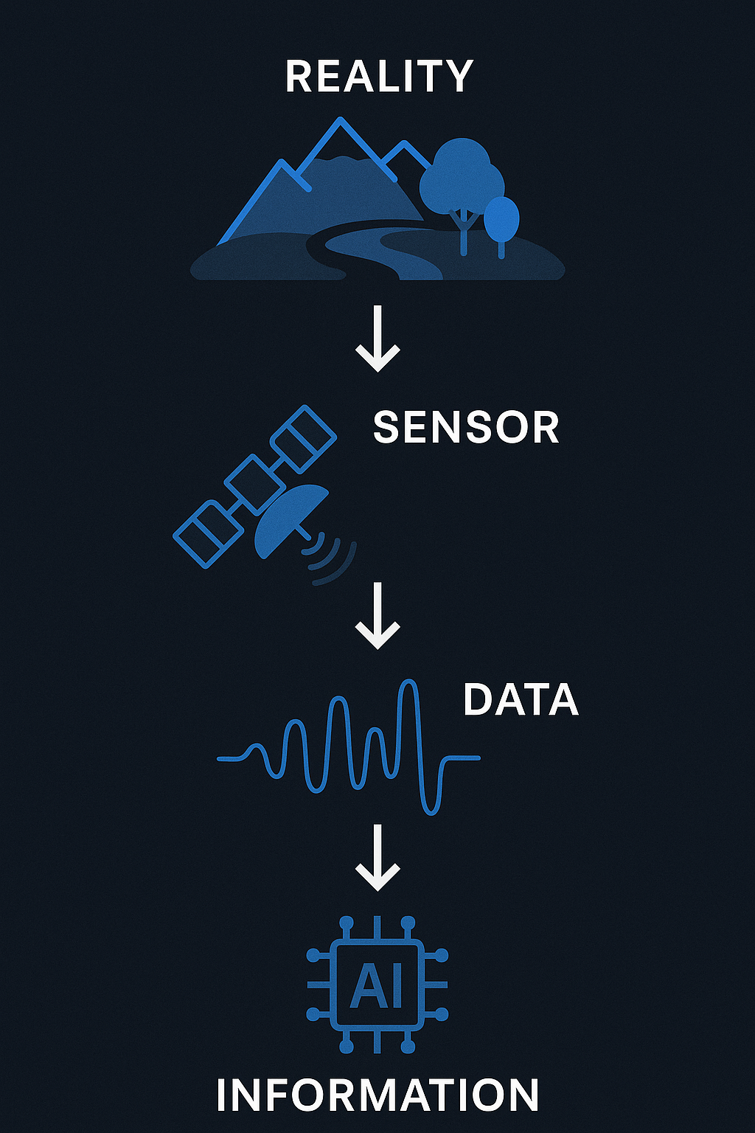
Chapter 1: From Reality to Information
Physical world → energy → sensor → pixels
Data processing + correction
Analysis & domain knowledge → decision support

Slide 6
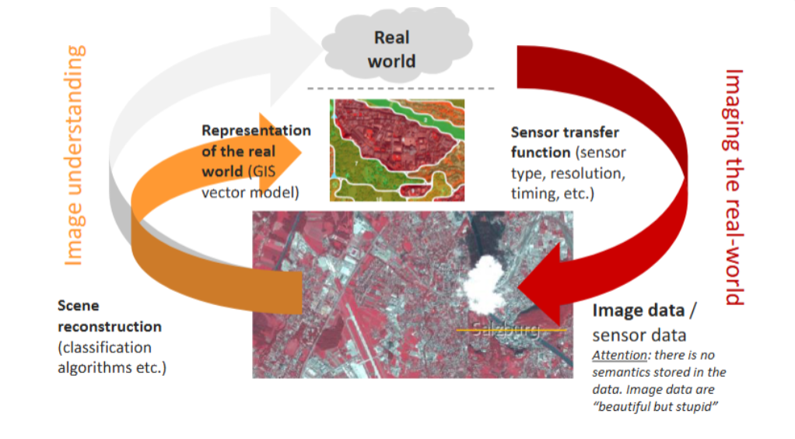
From the real world to sensor data to scene reconstruction. Image from UNIGIS Salzburg based on (Blaschke, 2010)

Slide 7
From Sensor Data to Information
Sensor transfer function: conceptual model linking real world → image
Attributes: spectral range, spatial resolution, temporal repeat, atmospheric sensitivity
Determines which features are captured vs. ignored (Richards, 2022)
Process is selective and lossy → only certain scene characteristics preserved
¨Scene reconstruction = interpretation of sensor data
Combines raw data + context + prior knowledge
Transforms pixels → semantic info (land cover classes, objects) (Blaschke, 2010)

Slide 8
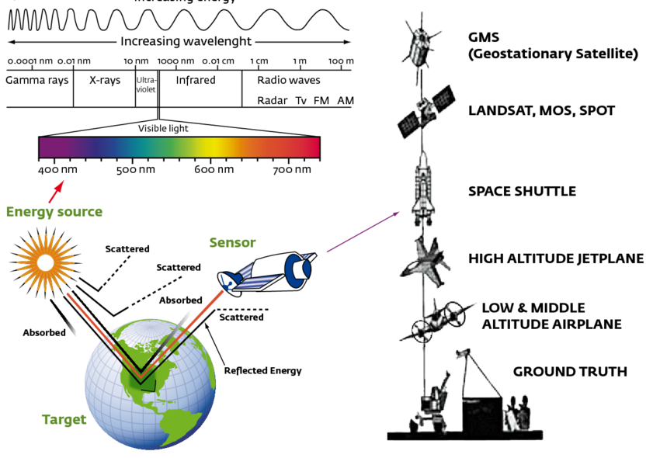
Introduction to Remote Sensing
Remote sensing = acquisition of Earth surface/atmosphere information without direct contact
Platforms: satellites, aircraft, drones
Principle: detection of electromagnetic radiation
Naturally emitted or reflected (passive)
Artificially transmitted and scattered back (active)
Theory of remote sensing of the earth Electromagnetic spectrum of energy radiations
Remote sensing platforms with Sensors on board (Omuto et al., 2012)

Slide 9
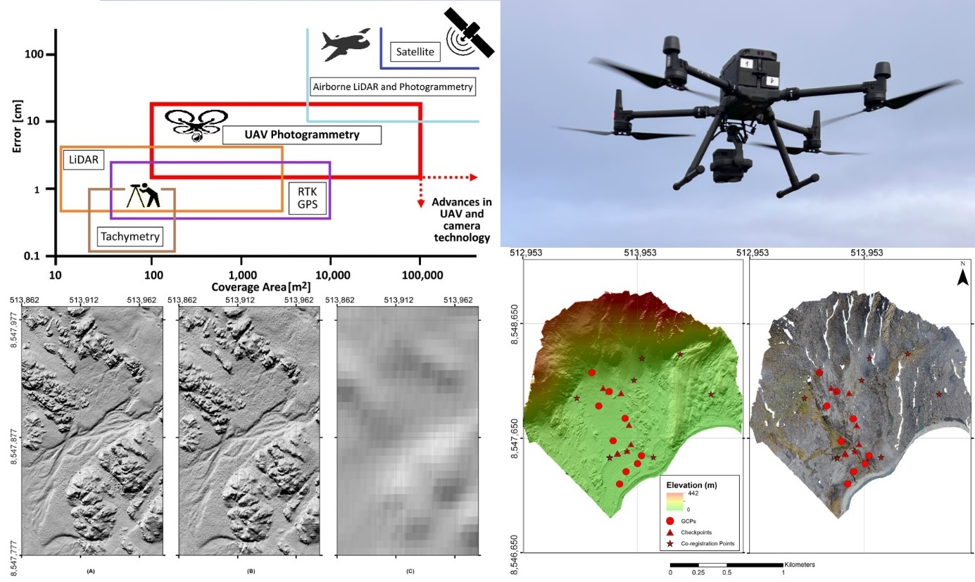
Different Carriers – Same Goal
Ground
UAVs
Airplanes & Helicopters
Satellites
Goal:
Getting Data through Sensors without touching the Object
Graphical Abstract (Alphonse et al., 2023)

Slide 10
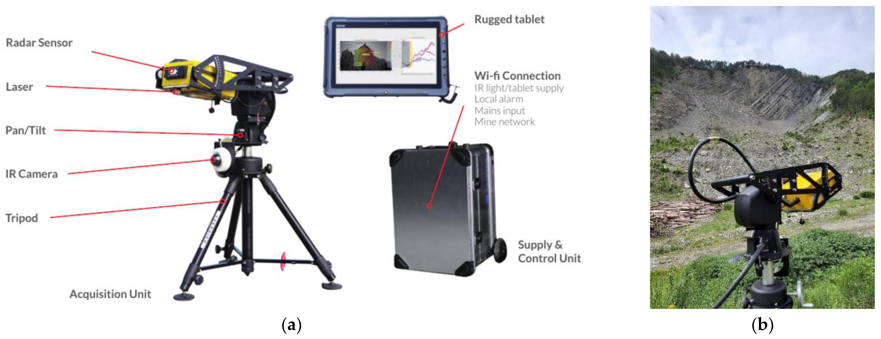
Ground
https://www.mdpi.com/1424-8220/21/8/2632

Slide 11
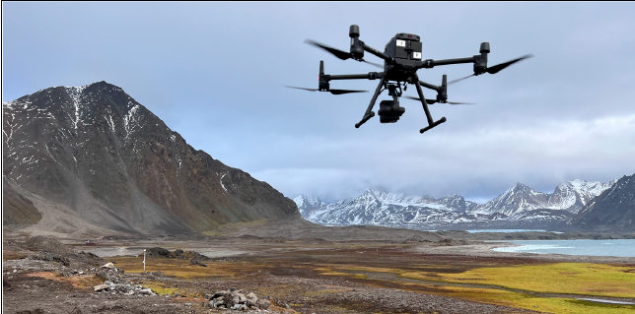
UAVs
DJI Matrice 300 RTK Drone equipped with Zenmuse P1 camera during the mission at Fuglebekken catchment. (Alphonse et al., 2023)

Slide 12
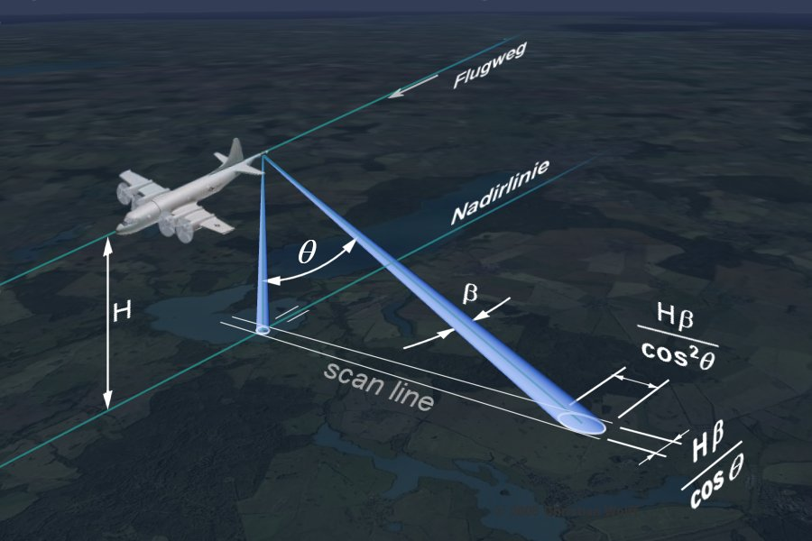
Airplanes
https://www.radartutorial.eu/20.airborne/ab06.en.html

Slide 13
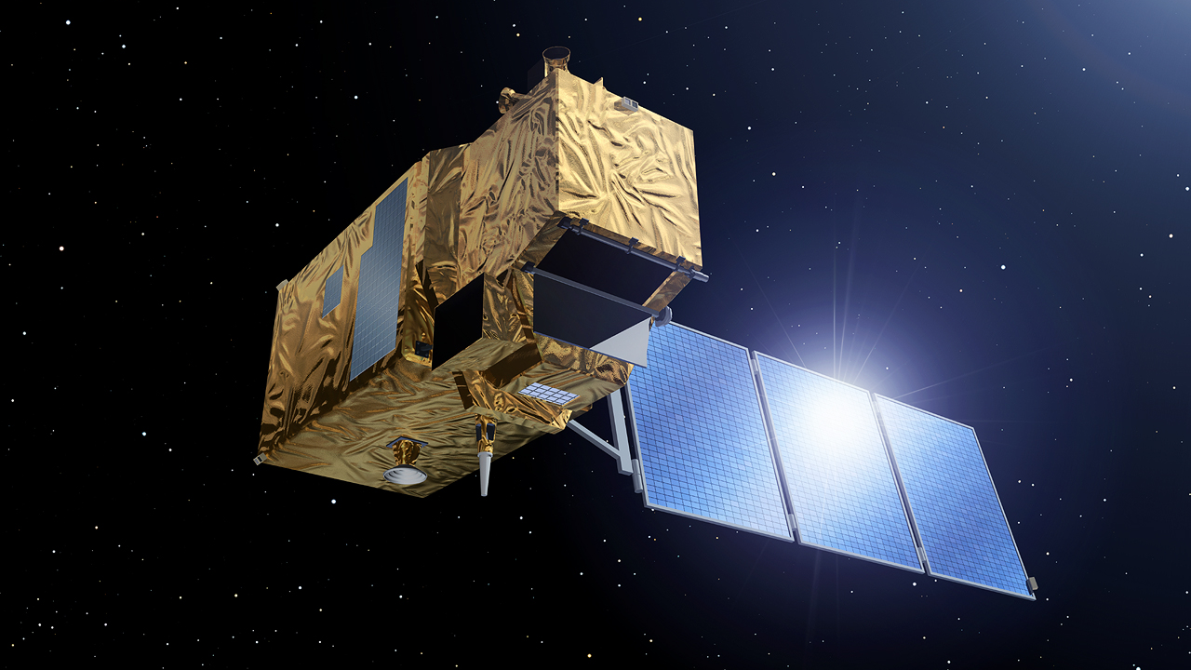
Satellites
https://sentiwiki.copernicus.eu/web/sentinel-2

Slide 14
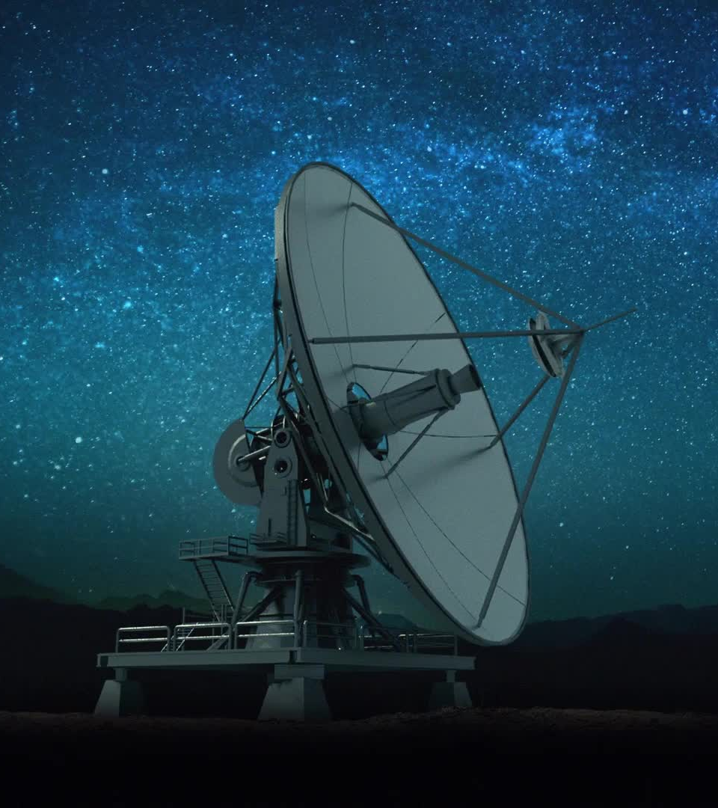
Important Notice
Ante Elon: Satellites were launched by governments
Post Elon: Satellites became commercial products
BUT: Practically all Satellites are Dual-Use
Science
Military

Slide 15
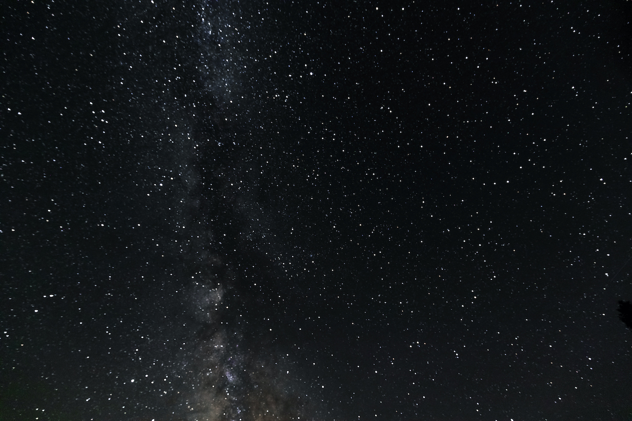
Chapter 2: Active & Passive Sensors
Passive: sunlight, thermal → cloud-sensitive
Active: radar, LiDAR → day/night, all-weather

Slide 16
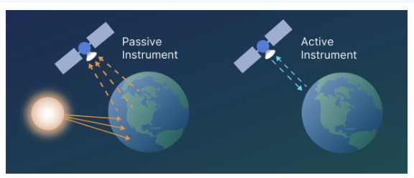
Active and Passive Sensors

Slide 17
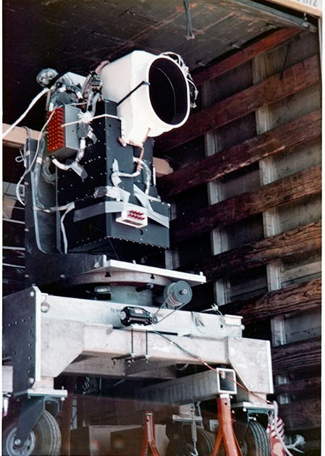
Active and Passive Sensors
Passive sensors rely on natural sources of energy, most commonly the sun, to measure reflected radiation in the visible to shortwave infrared part of the spectrum or emitted longwave infrared radiation in the thermal domain (James B. Campbell & Randolph H. Wynne, 2013; Jensen, 2016).
Optical
Thermal
Multispectral
Hyperspectral
Active sensors, generate their own signal, usually in the form of microwave or laser pulses, transmit it towards the Earth’s surface, and measure the backscattered return (Woodhouse, 2017).
LiDAR
RADAR / SAR

Slide 18
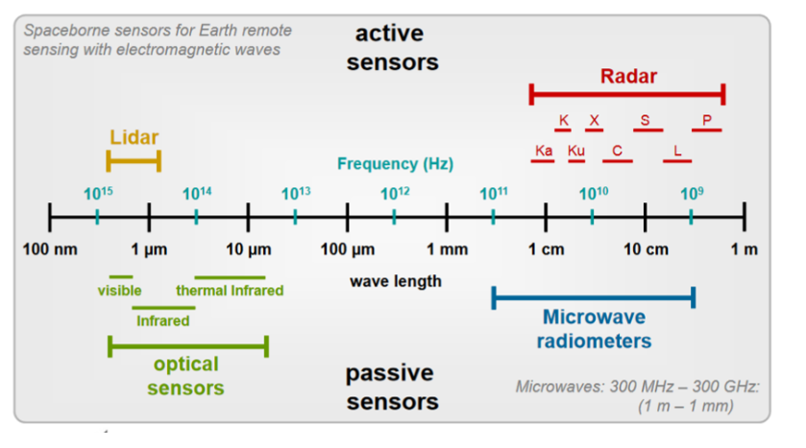
Electromagnetic Spectrum
The electromagnetic spectrum typically used in remote sensing, and spectral reflectance curves show the distinct signatures of vegetation, soil, and water, which are fundamental for interpretation (Jensen, 2016).

Slide 19


Slide 20
Passive Sensors
Passive sensors = optical + thermal instruments
Optical: reflected solar energy (visible, NIR, SWIR)
Thermal: emitted longwave radiation (surface temperature)
Spectral signatures:
Vegetation → red absorption, high NIR reflectance
Soil → mineral/organic-dependent curves
Water → strong NIR & SWIR absorption (appears dark)
Basis for optical remote sensing analysis
Multispectral & hyperspectral = passive systems
Limitation:
atmospheric interference (clouds, aerosols, water vapor)
Strength:
long record & global coverage:
Landsat (since 1972) → longest continuous record
MODIS (1999) → daily global, 36 bands

Slide 21
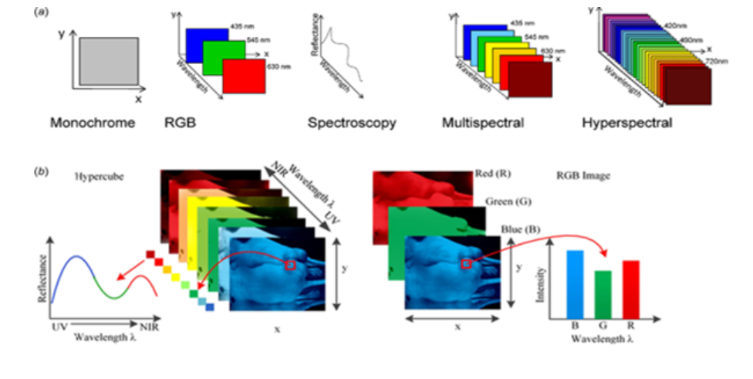
Passive Sensors
Monochrome, multispectral and hyperspectral imaging visualized (Mehta et al., 2018)

Slide 22
Optical
Optical remote sensing = most widely used passive modality
Sensor types:
Panchromatic → single broad band, very high spatial resolution, low spectral detail
Multispectral → 4–13 broad bands, effective for land cover, agriculture, urban, environment
Hyperspectral → hundreds of narrow, contiguous bands, high spectral detail for material ID & biophysical parameters
Very High Resolution (VHR) → sub-meter to few meters resolution, enables detailed urban mapping & object detection
Data processing:
Radiometric calibration → digital numbers → radiance
Atmospheric correction → removes scattering/absorption (O₂, O₃, H₂O)
Geometric correction → aligns imagery to Earth’s surface

Slide 23
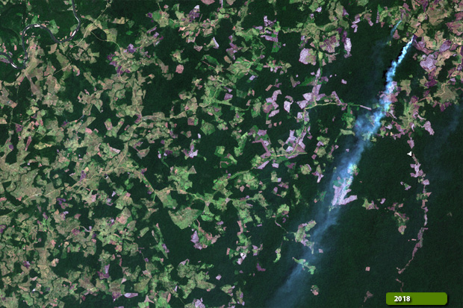
Optical
Strengths: interpretable, long historical record, broad applications
Limitations: cloud cover, atmospheric interference
Sentinel 2 - Optical Image / True Colour Composite. Source: ESA

Slide 24
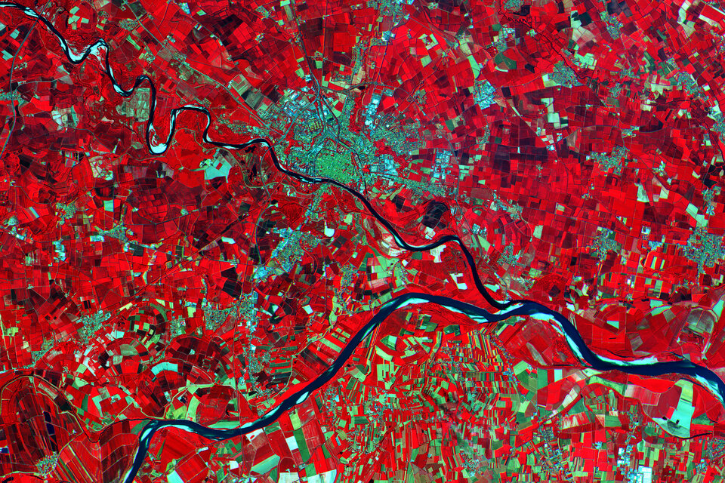
Multispectral Remote Sensing
False colour composite with RGB and NIR, Source: ESA Sentinel-2

Slide 25
Multispectral
Multispectral sensors:
measure reflected radiation in a limited number of broad spectral bands
Limitations:
restricted number of bands → weaker discrimination of subtle spectral differences
Strengths:
Balanced spatial, temporal, spectral resolution
Efficient data volume for processing & archiving
Applications:
Vegetation & water indices (e.g., NDVI, NDWI)
Burned area mapping
Land cover classification
Agricultural monitoring & yield estimation
Military

Slide 26
Multispectral Satellite Programs
Most widely used passive systems
= backbone of global monitoring for 50+ years
Landsat program (since 1972):
Longest continuous record
30 m resolution (VIS, NIR, SWIR)
Key instruments: TM, ETM+, OLI
Sentinel-2 MSI:
13 spectral bands (10–60 m)
5-day revisit cycle
Includes 3 red-edge bands → improved vegetation analysis
MODIS (Terra & Aqua):
Coarser resolution
Daily global coverage across 36 bands

Slide 27
Hyperspectral
Hyperspectral sensors capture hundreds of narrow, contiguous bands (5–10 nm) enabling detection of pigments, minerals, water content, and organic compounds
Imaging spectroscopy first developed with airborne systems (AVIRIS, HyMap) and later spaceborne sensors (Hyperion, PRISMA, EnMAP)
Provides continuous spectrum per pixel for quantitative retrieval of biophysical and geochemical parameters
Applications:
vegetation stress and physiology
mineral discrimination in geology
water quality monitoring in aquatic systems
Challenges:
high dimensionality
Noise
atmospheric interference
requires radiometric, atmospheric, and geometric correction plus dimensionality reduction
Recent missions: PRISMA (2019, 239 bands, 30 m), EnMAP (2023, 242 bands, 30 m)
Future missions: ESA CHIME, NASA SBG → expanding global hyperspectral capacity and advancing imaging spectroscopy

Slide 28
Table of Hyperspectral Sensors
 | Satellite based |  |  |  |  | Airplane - based |  |  |  | UAV-based
Sensor | Hyperion | PROBA-CHRIS | PRISMA | ENMAP | CRISM | AVIRIS | CASI | AISA | HyMap | Headwall | Hyperspec UHD 185 - Firefly
Spectral range [nm] | 357-2576 | 415-1050 | 400-2500 | 420-2450 | 362-3920 | 400-2500 | 380-1050 | 400-970 | 440-2500 | 400-1000 | 450-950
No. of Spectral bands | 220 | 19 or 63 | 238 | 242 | 544 | 224 | 288 | 244 | 244 | 270(Nano) 324(Micro) | 138
Spectral Resolution [nm] | 10 | 34 or 17 | 12 | 6.5 and 10 | 6.55 | 10 | <3.5 | 3.3 | 3.3 | 6 (Nano) 2.5 (Micro) | 4
Operational Altitude [km] | 705 | 830 | 615 | 652 | 300 (over Mars!) | 1-20 | 1-20 | 1-20 | 1-20 | <0.15 | <0.15
Spatial resolution [m] | 30 | 17-36 | 30 | 30 | 15-200 | 1-20 | 1-20 | 1-20 | 1-20 | 0.01-0.5 | 0.01-0.5
Year | 2000 - 2017 | 2001 - 2024 | 2019 - | 2022 -- | 2006 - 2022 | 1987 - | 1989- | 1996- | 1997- | 2020 | 2020
Overview of Hyperspectral Sensors. Specifications compiled from : (Babey & Anger, 1993; Barnsley et al., 2004; Cocks et al., 1998; Green et al., 1998; Headwall Photonics - Hyperspectral Imaging Systems & Components, n.d.; Table 1 Spectral Characteristics of the CASI Data, n.d.; Kirrilly Pfitzner, 2004; Loizzo et al., 2018; Miko, n.d.; S. Murchie et al., 2007; S. L. Murchie et al., 2009; Pearlman et al., 2003; van der Meer et al., 2012).

Slide 29
Vicarious Calibration and Atmospheric Correction
Accurate hyperspectral analysis requires atmospheric correction to convert radiance to surface reflectance
Atmospheric gases (O₂, O₃, CO₂, H₂O) produce absorption features that can be misinterpreted as surface signatures if uncorrected
Multispectral sensors often avoid major absorption bands, but hyperspectral sensors cover full spectrum and are highly sensitive to atmospheric effects
Correction ensures reliable identification of surface materials and prevents misinterpretation of gas absorption features
Dedicated software: MODTRAN, FLAASH used for atmospheric correction
When unavailable, vicarious calibration methods apply ground reference targets or invariant features for approximate corrections
Vicarious calibration does not allow strict spectral comparison but provides sufficiently accurate reflectance for material identification and scene analysis

Slide 30
Spectral Indices
Spectral indices are mathematical combinations of spectral bands designed to highlight properties of the Earth’s surface
They simplify complex reflectance patterns by emphasizing vegetation, water, or disturbance features
NDVI (Tucker, 1979): uses red absorption by chlorophyll and NIR reflectance of plant cells → values near 1 = dense vegetation, near 0/negative = soil or water
NDWI (Gao, 1996): green and NIR bands to detect water bodies
NBR (Key & Benson, 2006): shortwave infrared bands to map burned areas and fire severity
MSAVI (Qi et al., 1994): corrects soil influence in sparsely vegetated areas, useful in arid regions
In hyperspectral data, specialized indices detect narrow absorption features:
PRI (Gamon et al., 1992) for photosynthetic efficiency
Red-edge indices for chlorophyll concentration (Delegido et al., 2011)
Indices are computationally simple and effective for global vegetation monitoring, drought detection, deforestation mapping, and yield estimation
Limitations include atmospheric interference, calibration issues, and saturation in dense vegetation
Despite challenges, spectral indices remain fundamental tools in remote sensing

Slide 31
Active Sensors
Active remote sensing systems transmit their own energy and record the backscattered response
Operate independently of sunlight, usable day and night, and penetrate clouds, haze, and smoke
Radar is the most widely used active sensing technology, working in the microwave spectrum
Lidar uses laser pulses in visible/NIR range, mainly for DSM, DEM, topographic mapping, and vegetation structure analysis
Radar sensitivity: surface roughness, moisture content, dielectric properties
Early radar (1930s–40s) showed object detection with radio waves; side-looking airborne radar (SLAR) in 1950s enabled systematic Earth imaging
Lidar measures return time of laser pulses → very high vertical resolution of canopy and terrain
Lidar limited in spatial coverage from satellites but essential in airborne campaigns
Radar provides global satellite coverage and is a cornerstone of Earth observation

Slide 32
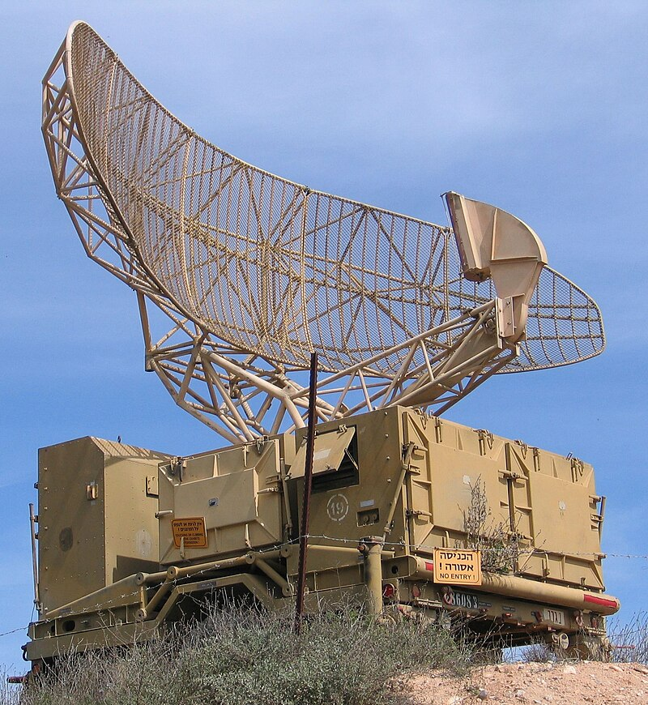
Basic Principles of Radar
Radar (RAdio Detection And Ranging) is an active remote sensing system transmitting microwave pulses and recording backscatter from Earth’s surface
Unlike passive optical sensors, radar generates its own illumination → independent of sunlight, unaffected by clouds, haze, or smoke → provides consistent all-weather, day-and-night observations
Origins in early 20th century radio wave experiments; rapid development in 1930s–40s for military applications (aircraft detection, navigation) with pioneers such as Robert Watson-Watt
Post-WWII radar adapted for scientific uses, including meteorology and geoscience
1950s: introduction of Side-Looking Airborne Radar (SLAR) providing continuous ground imagery; limited azimuth resolution due to antenna size constraints
Breakthrough with Synthetic Aperture Radar (SAR): uses platform motion to synthesize a long antenna, greatly improving resolution
1978: NASA’s Seasat demonstrated feasibility of spaceborne SAR, proving global radar imaging from orbit
1990s: dedicated SAR missions (ESA ERS-1/2, Canada Radarsat-1) established systematic environmental monitoring and solidified radar’s role in Earth observation
Radar of the type used for detection of aircraft. It rotates steadily, sweeping the airspace with a narrow beam. Air Force Museum, Hatzerim, Israel. Source: Wikipedia

Slide 33
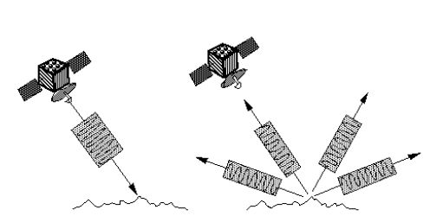
Basic Principles of Radar
transmitting microwave pulses
recording backscattered energy
using system geometry and wavelength to capture information about the Earth’s surface
(Torres et al., 2012)
Echoes received back by the Antenna (European Space Agency, 2007)

Slide 34
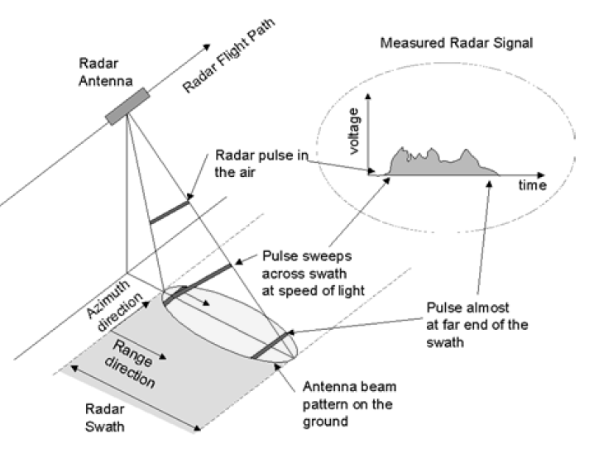
Sidelooking Radar
Side-looking airborne radar (SLAR) was the first major advance in radar imaging
An aircraft-mounted antenna transmitted pulses obliquely to the ground and recorded backscatter to form images
Resolution limited by antenna length: higher altitude → wider footprint → reduced azimuth resolution
Constraint made SLAR unsuitable for high-resolution spaceborne applications
Imaging geometry for a side-looking radar system (Van Zyl & Kim, 2011)

Slide 35
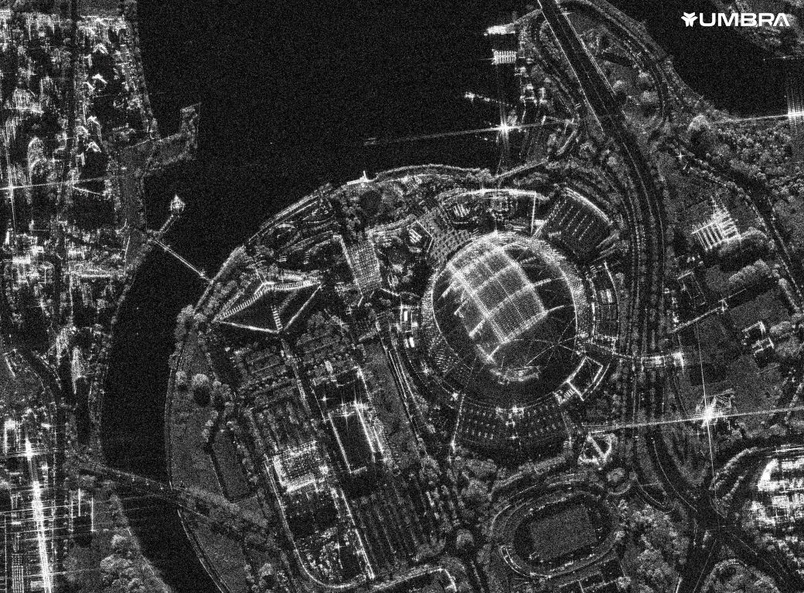
Synthetic Aperture Radar (SAR)
Synthetic aperture principle invented by Carl Wiley in 1952
Exploited Doppler frequency shifts from platform motion to synthetically extend antenna length
Coherent combination of successive radar pulses formed a “synthetic” antenna, enabling much finer azimuth resolution than physical antennas
Foundation for Synthetic Aperture Radar (SAR)
First spaceborne SAR: NASA’s Seasat (1978), operated 106 days, proved feasibility for global monitoring
Subsequent missions built global SAR capacity:
ESA ERS-1 (1991) and ERS-2
Canada’s Radarsat series
Japan’s ALOS PALSAR missions
ESA Sentinel-1 (since 2014, open-access C-band SAR)
https://www.maxar.com/maxar-intelligence/products/sar-imagery

Slide 36
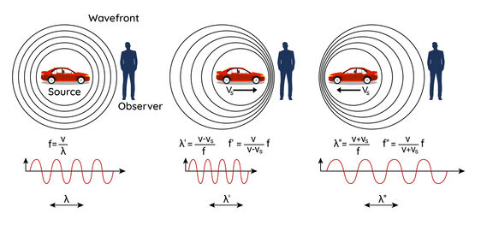
Doppler Effect in SAR
The Doppler effect is the frequency shift caused by relative motion between source and receiver
Approaching targets → higher frequency, receding targets → lower frequency
Successive echoes along the flight path are coherently combined using these Doppler shifts
Processing across varying frequencies synthesizes a much longer antenna aperture
Result: improved azimuth resolution and smaller effective ground pixel size
https://www.optomet.com/knowledge-technology/doppler-effect/

Slide 37
SAR Frequency Bands and Applications
SAR instruments operate at different microwave frequency bands, each with specific characteristics and applications
X-band (2.4–3.8 cm): very high spatial resolution, suited for urban monitoring and infrastructure studies, limited vegetation penetration
C-band (3.8–7.5 cm): long-standing workhorse (e.g., Sentinel-1), balances resolution, canopy penetration, and wide-swath imaging
L-band (15–30 cm): deeper penetration into vegetation canopies, essential for biomass estimation, forest monitoring, and subsurface detection in dry soils
P-band (30–100 cm): strongest penetration, enables measurement of forest structure and biomass, but affected by ionospheric distortions; ESA Biomass mission will provide first global P-band SAR observations

Slide 38
SAR Frequency Bands and Applications
Name | Wavelength | Example of sensors | Example of typical applications
P-band | ~ 65 cm | NISAR,Biomass | First P-band spaceborne; vegetation mapping and assessment
L-band | ~ 23 cm | ALOS PALSAR | Medium resolution SAR (geophysical monitoring; biomass and vegetation mapping; high penetration, InSAR)
S-band | ~ 10 cm | NISAR | Agriculture monitoring, higher vegetation density
C-band | ~ 5 cm | ERS-1/2 SAR, RADARSAT-1/2, ENVISAT ASAR, RISAT-1, Sentinel-1 | SAR Workhorse (global mapping; change detection; monitoring of areas with low to moderate penetration; higher coherence); ice, maritime ocean navigation
X-band | ~ 3 cm | TerraSAR-X,COSMO-SkyMed, Capella, ICEYE | High-resolution SAR (urban monitoring; ice and snow, little penetration into vegetation cover; fast coherence decay in vegetated areas)
K-band | ~ 1.2 cm | - | Primarily climate & atmosphere-related applications, e.g. H2O absorption & rainfall. Also, military domain applications, e.g., surveillance
SAR Bands (Flores et al., 2019)

Slide 39
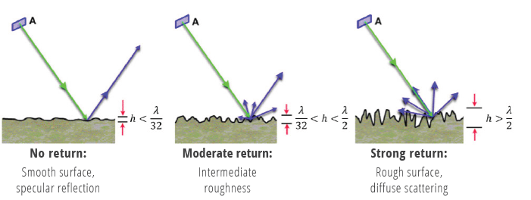
Reflection
Conceptual sketch of the dependence of surface roughness on the sensor wavelength λ: (a) smooth, (b) intermediate, and (c) rough. (Flores et al., 2019)

Slide 40
Reflection
In radar and SAR, backscatter depends on surface geometry, roughness, and dielectric properties
Smooth surfaces (e.g., calm water) reflect energy away → appear dark
Rough surfaces and complex targets scatter energy back → appear bright
Urban areas produce strong returns via double-bounce reflections
Vegetation canopies generate volume scattering
SAR records both amplitude and phase, enabling intensity imaging plus advanced methods like interferometry and polarimetry
These techniques provide information beyond what optical imagery can capture

Slide 41
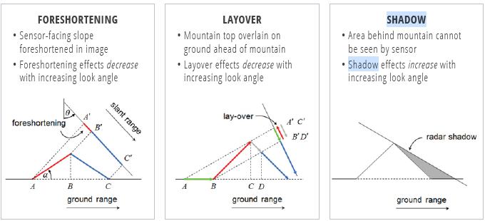
Geometric Distortions
Main geometric distortions on SAR images with their dependence on acquisition geometry: (a) foreshortening, (b) layover, and (c) shadow. (Flores et al., 2019)

Slide 42
Geometric Distortions
SAR images are affected by geometric distortions due to side-looking geometry
Foreshortening: slopes facing sensor appear compressed
Layover: tall objects imaged before their base
Radar shadows: steep terrain blocks illumination, leaving dark areas
Distortions can be corrected using digital elevation models (DEMs) for geometric correction

Slide 43
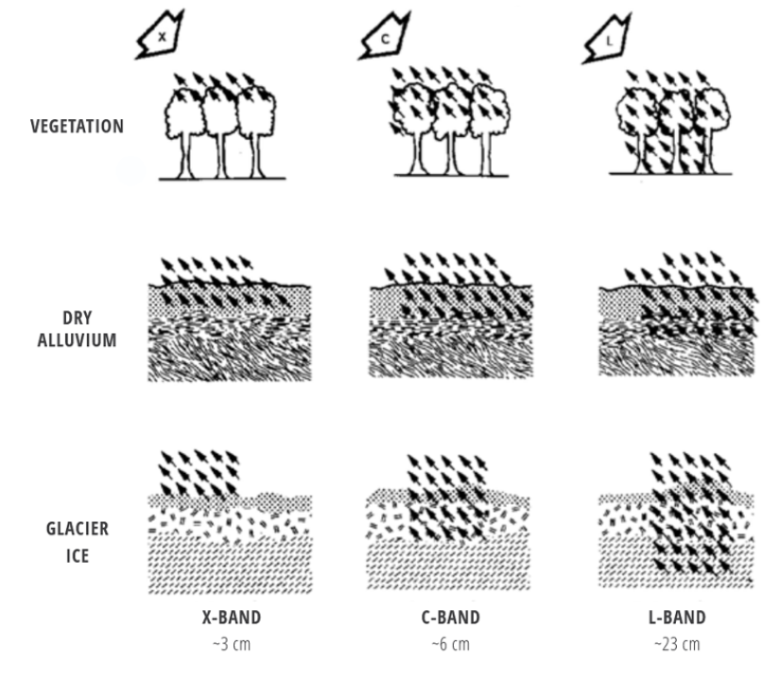
Penetration
SAR penetration depends on wavelength, polarization, and target dielectric properties
Longer wavelengths (L-band, P-band) penetrate deeper into vegetation and dry soils; shorter X-band is limited to surface interactions
In forests, L-band and P-band interact with trunks and branches → useful for structure and biomass estimation
Soil penetration decreases with higher moisture, as water strongly absorbs microwaves
Dry snow and sand allow deeper penetration; wet snow, water, or saturated soils appear dark due to absorption and reflection
Applications include soil moisture retrieval, flood mapping under vegetation, and monitoring permafrost and ice structures
Penetration of different wavelengths for different materials (Meyer, 2019)

Slide 44
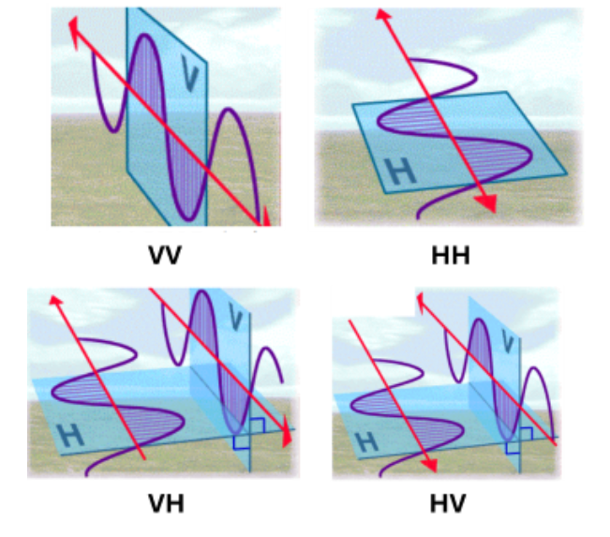
Polarization
Single polarization | HH or VV
Single polarization | HH or VV
Dual polarization | HH + HV, or VV + VH, or HH + VV
Alternating polarization | HH + HV, alternating with VV + VH
Polarimetric (Quad-pol | HH, VV, HV, VH
Polarization is a key dimension in radar measurements
Modern SAR systems transmit and receive in horizontal (H) or vertical (V) modes
Four polarization combinations: HH, HV, VH, VV
Co-polarized channels (HH, VV) → surface scattering and double-bounce effects
Cross-polarized channels (HV, VH) → sensitive to volume scattering, especially in vegetation canopies

Slide 45
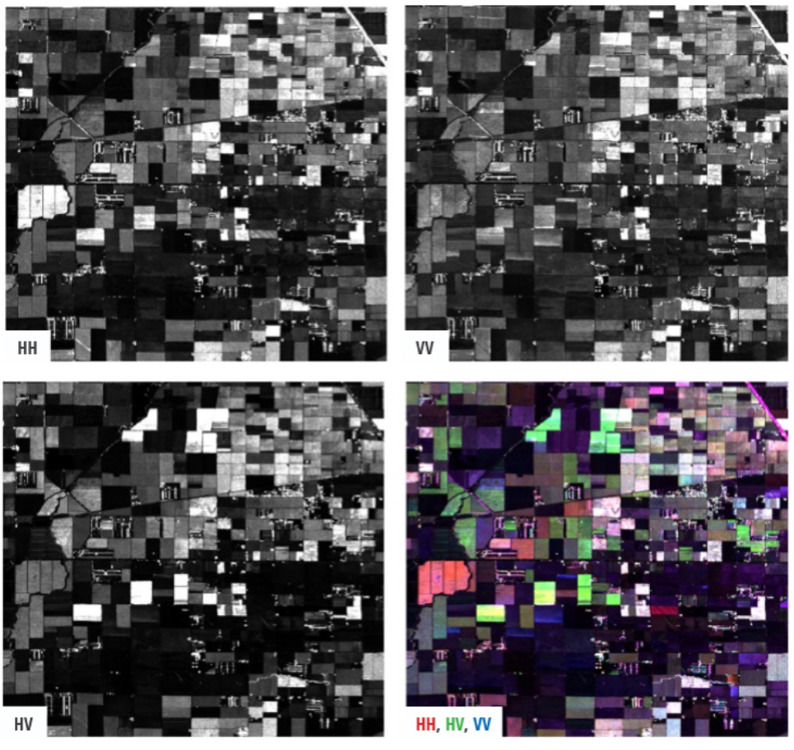
Polarization
Illustration of how different polarizations (HH, VV, HV, and color composites) bring out different features in an agricultural scene from California’s Central Valley. The different orchards and crops in this area display different polarized backscatter behavior (Flores et al., 2019, p. 219)

Slide 46
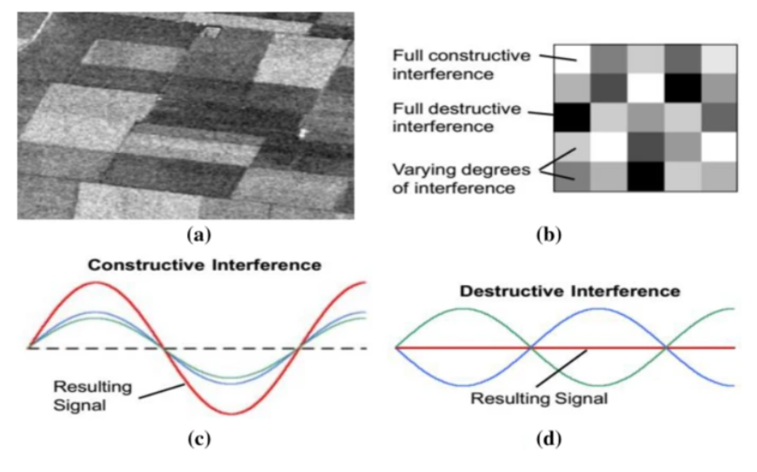
Speckle
Speckle is a granular texture in SAR imagery caused by coherent interference of scattered waves within a resolution cell
It is multiplicative noise, often modeled by an exponential distribution, and while it carries statistical information, it complicates interpretation and analysis
Speckle reduction is a key preprocessing step in SAR
Classical filtering approaches:
Lee filter (adaptive, preserves edges)
Frost filter (statistical smoothing)
Multilooking (averages independent looks, reduces variance but lowers spatial resolution)
Modern approaches:
Non-local means (NLM) → compares image patches, averages statistically similar ones, preserves fine details
Iterative weighted maximum likelihood NLM (Deledalle et al., 2009) → uses statistical similarity and iterative refinement, superior for low SNR SAR data
Balancing speckle reduction with detail preservation is critical for accurate classification and quantitative analysis
Illustration of the speckle effect from Singh et al. (2021):
Agricultural fields showing a grainy texture caused by
(c) constructive and
(d) destructive interference of backscattered waves

Slide 47
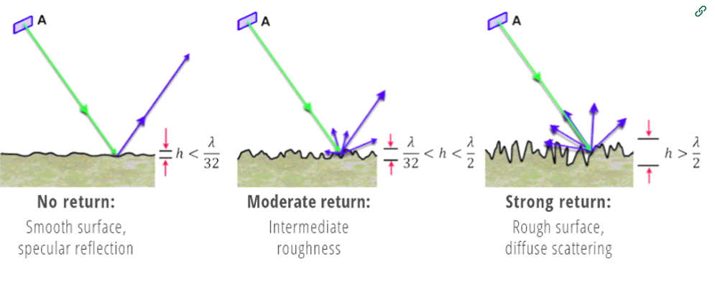
Backscattering Basics
Backscattering in SAR is the portion of the transmitted microwave pulse scattered back to the sensor after interacting with the surface
Return signal depends on geometry, dielectric properties, and roughness of the target
Roughness as a factor of backscattering (Meyer, 2019)

Slide 48
Backscattering Basics
HH backscatter → strong in double scattering from man-made structures (e.g., buildings, ships, corner reflectors)
VV backscatter → linked to surface scattering from rough surfaces (e.g., bare soils, disturbed water)
VH backscatter → characteristic of volume scattering within vegetation and forest canopies
These scattering distinctions form the basis of SAR image interpretation and signature analysis
Roughness as a factor of backscattering (Meyer, 2019)

Slide 49
Backscattering Basics
X-band (~3 cm) → interacts mainly with the canopy top, sensitive to leaves and small branches, limited penetration.
C-band (~6 cm) → penetrates deeper than X-band, interacts with mid-canopy and larger branches, commonly used for vegetation and soil moisture studies.
L-band (~23 cm) → penetrates through canopy, interacts with trunks and ground surface, enabling biomass estimation and subsurface detection in dry soils.
Penetration depth increases with wavelength → shorter wavelengths capture fine canopy details, while longer wavelengths reveal forest structure and ground conditions.
Radar backscattering mechanisms for different SAR wavelengths: X- and C-band (left) and L-band (right) (Ottinger & Kuenzer, 2020)

Slide 50
RADAR Cross Section (RCS)
Radar cross section (RCS) expresses the strength of the backscattered signal
Controlled by multiple factors:
Surface roughness relative to radar wavelength
Dielectric constant of the target material
Incidence angle of the radar beam
Geometric arrangement of scatterers
Wavelength plays a key role:
Longer wavelengths (L-, P-band) → deeper penetration into vegetation and dry soils
Shorter wavelengths (X-band) → interact mainly with fine-scale features such as leaves and small branches

Slide 51
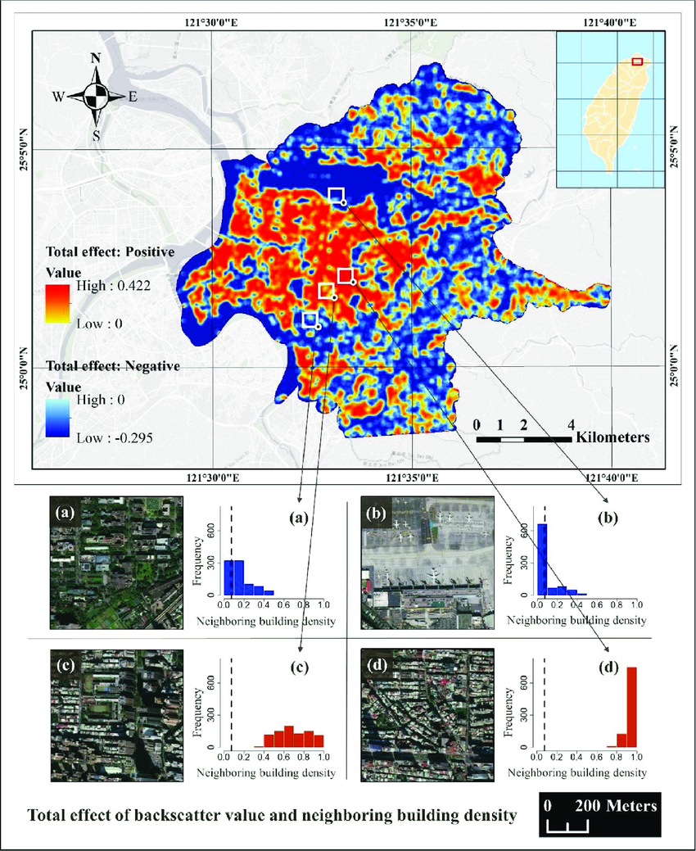
Backscatter: practical Use
Main map shows spatial distribution of total backscatter effects in an urban area.
Positive values (red–yellow) → strong backscatter, linked with high neighboring building density.
Negative values (blue) → weak backscatter, often associated with low density or open areas such as water.
Study area is georeferenced: Taiwan, (coordinates provided).
Insets:
(a) Low-density residential → weak backscatter, histogram skewed toward low values.
(b) Industrial/parking area → weak backscatter, histogram concentrated at very low density.
(c) Medium-density urban core → higher, mixed backscatter values, histogram more balanced.
(d) High-density residential blocks → strong backscatter, histogram peaks at high density.
Interpretation:
Backscatter intensity correlates with neighboring building density.
High density = stronger radar returns due to multiple scattering (double-bounce).
Low density or water = weaker returns (smooth surfaces, low scattering).
Practical use:
Demonstrates how SAR backscatter can be applied in urban structure analysis and urban water detection.
Backscatter: Total effect of the backscatter values in urban water detection (Liao & Wen, 2020)

Slide 52
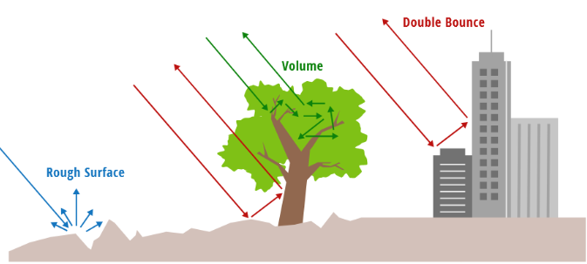
Scattering Types

Slide 53
Scattering Types
Specular Scattering
Occurs on smooth surfaces relative to radar wavelength
Energy reflected away from sensor → very low backscatter
Examples: calm water, smooth asphalt → appear dark in SAR imagery
Diffuse Scattering
Happens as surface roughness increases relative to wavelength
Energy scattered in multiple directions → stronger returns
Examples: bare soil, agricultural fields, disturbed water
Volume Scattering
Radar waves penetrate medium and undergo multiple reflections
Typical in vegetation (leaves, twigs, trunks), snow, or fine soils
Produces strong cross-polarized returns (HV, VH)
Crucial for forest and vegetation studies

Slide 54
Scattering Types: Double Bounce Scattering
Double-bounce scattering occurs when a radar wave is reflected twice before returning to the sensor
Typical geometry: vertical surface (building wall, tree trunk) + adjacent horizontal surface (ground, calm water) → efficient corner reflector
Produces strong radar returns, especially in urban areas (buildings, ports, ships)
In forests, can occur between trunks and ground, especially in flooded vegetation → useful for wetland monitoring
Polarimetric SAR detects double-bounce via strong co-polarized signals (HH, VV), enabling separation from surface and volume scattering
Scattering distinctions:
Strong HH → predominance of double scattering, man-made structures appear bright
Strong VV → rough surface scattering (bare soils, rough water)
Strong VH → volume scattering (vegetation, forest canopies)

Slide 55
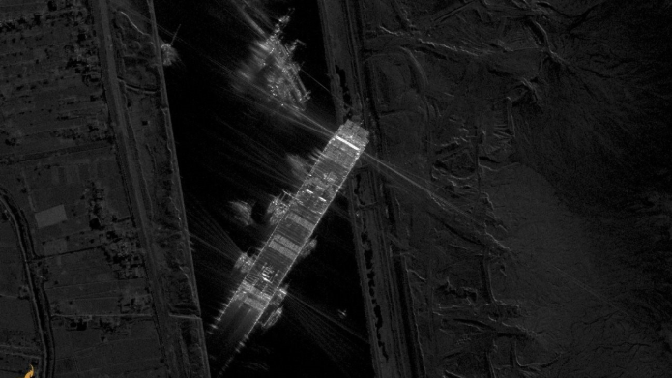
Ever Given container ship blocks the Suez Canal showing Double Bounce Effects at the back of the ship.
(Source: Capella Space (2021, https://www.capellaspace.com/gallery/ever-given-container-ship-blocks-the-suez-canal/)

Slide 56
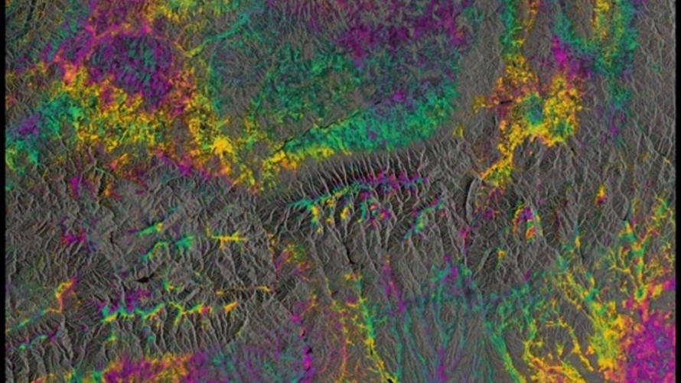
Advanced SAR Techniques
Sentinel 1: interferometric SAR (InSAR) Image. Source: ESA

Slide 57
SAR: beyond optical Capabilities
InSAR, Polarimetric SAR and Coherence Analysis extend SAR beyond optical capabilities, providing insights into:
vegetation structure
soil conditions
urban environments

Slide 58
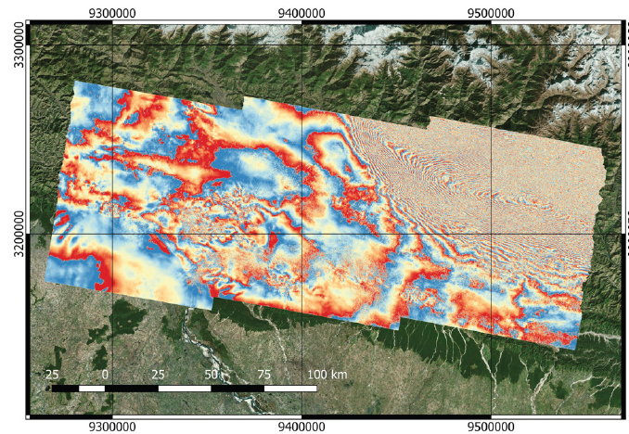
InSAR
SAR interferometry (InSAR) measures phase differences between acquisitions to derive elevation models and ground deformation with centimeter precision
Applications: earthquake displacement mapping, volcanic monitoring, glacier velocity measurements
Interferometric Synthetic Aperture Radar (InSAR) uses phase differences between multiple SAR acquisitions to measure topography and ground deformation
Provides centimeter- to millimeter-level precision in detecting surface changes
Sentinel-1 time series enable generation of interferograms, where colored fringes represent subtle displacements over time
InSAR builds on radar’s long history, with innovations like synthetic aperture processing expanding resolution and applicability
Widely used for monitoring earthquakes, volcanoes, landslides, subsidence, and infrastructure stability
Time-series methods (PS-InSAR, SBAS-InSAR) achieve millimetric precision over years → critical for infrastructure monitoring and hazard assessment
Geocoded Gorkha earthquake interferogram mapped in QGIS. The interferogram is used measure and map ground deformation with very high precision (Flores et al., 2019).
Closely spaced fringes → larger deformation gradients (the ground is moving more abruptly over short distances).
Widely spaced fringes → smaller deformation gradients (the ground is moving more smoothly).

Slide 59
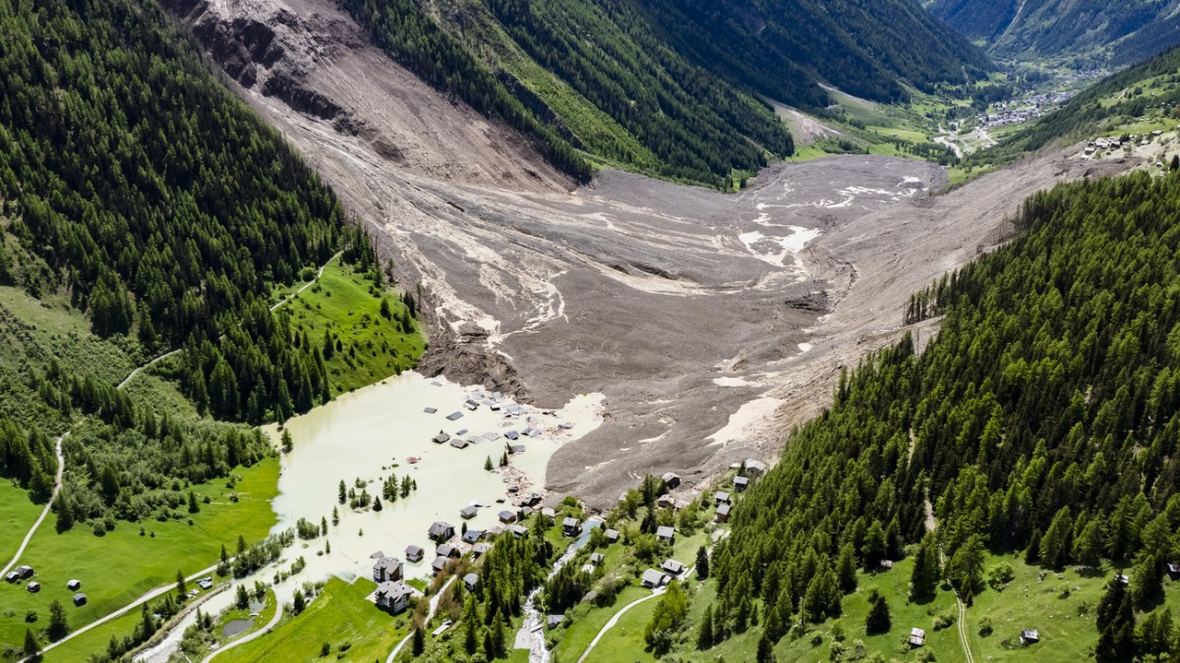
InSAR Use Case: Blatten, Lötschental

Slide 60
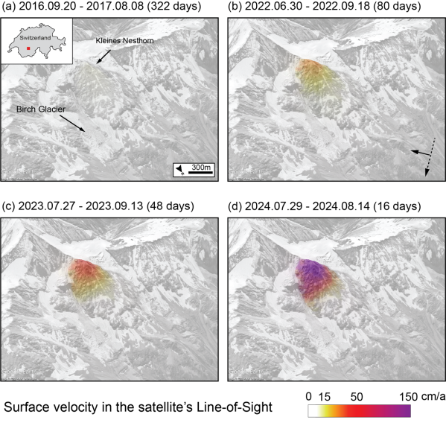
InSAR Use Case: Blatten, Lötschental
Surface velocity in the satellite’s Line-of-Sight (LoS) over the Birch Glacier and Kleines Nesthorn, derived from selected L-band interferograms spanning from 2016 to 2024.
(a) ALOS 2 PLASAR2 data T096D-F2-5
(b-d) SAOCOM-1 S4-T213. Images are acquired in descending orbit, right looking mode (see arrows in panel b for reference).
Velocities range from <15 cm/year (yellow) to >150 cm/year (purple).
The interferograms reveal increasing velocities in the years before the 2025 rock/ice avalanche occurred.
https://eo4society.esa.int/2025/08/08/satellite-radars-reveal-early-signs-of-slope-instability-years-before-blatten-rock-ice-avalanche/

Slide 61
Polarimetric SAR
Polarimetric SAR enables scattering decomposition:
Freeman–Durden model → separates surface, double-bounce, volume scattering
Yamaguchi model → adds helix scattering for more detailed classification
These approaches extend SAR beyond optical capabilities, providing insights into vegetation structure, soil conditions, and urban environments

Slide 62
Coherence Analysis
Coherence analysis quantifies correlation between acquisitions; loss of coherence signals change (building collapse, flooding, vegetation disturbance) → valuable for disaster monitoring and land cover studies

